Slide 1
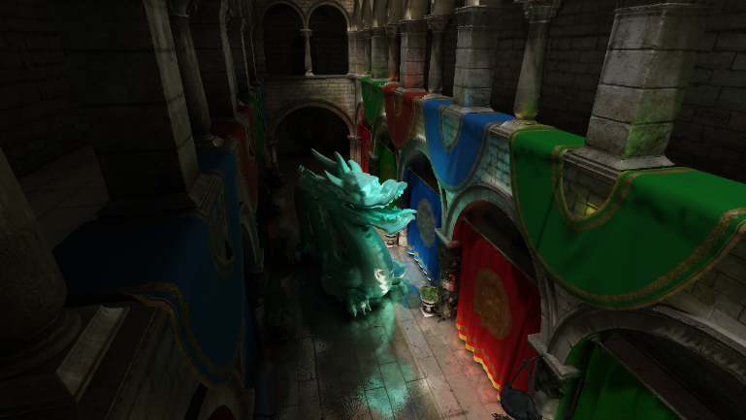
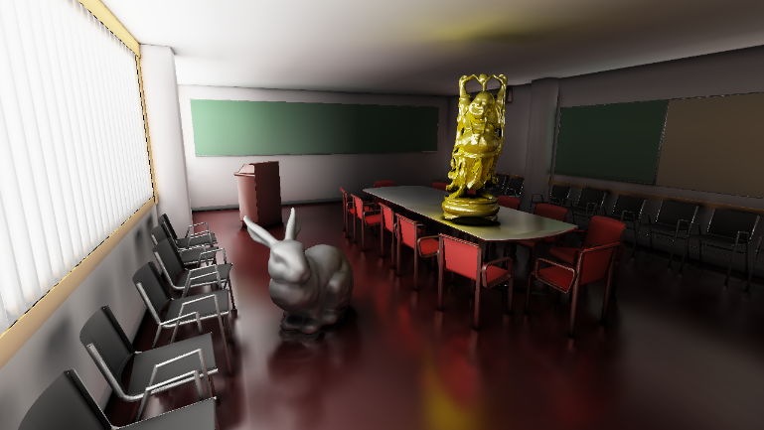
Trazado de Conos para el Cálculo de Iluminación Global empleando Sombreado de Vóxeles
Tutor: Esmitt Ramírez
Bachiller: José Villegas

Slide 2
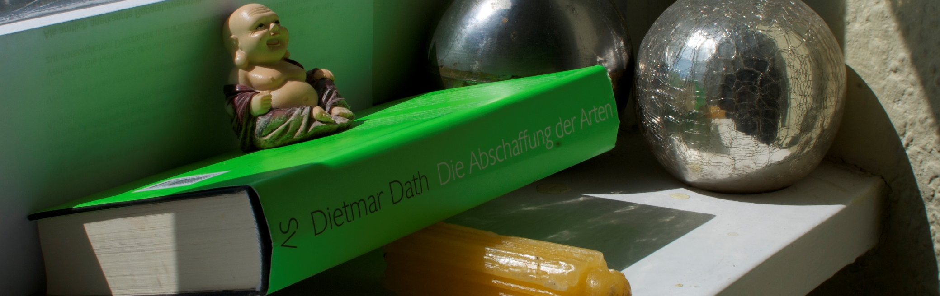
Iluminación Global
Importante para la generación de imágenes realistas
Luz Directa
Luz Directa
Luz Directa
Luz Directa
Sombras Indirectas
Reflecciones
Iluminación Indirecta
Cáusticas
Dispersión (Scattering)
[RDG+12]
Notes:
Explicar que es iluminación global, nombrar fenómenos (corto)

Slide 3
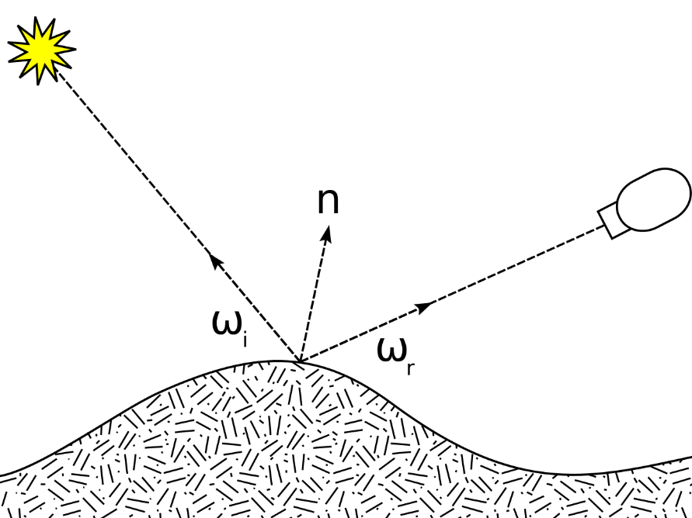
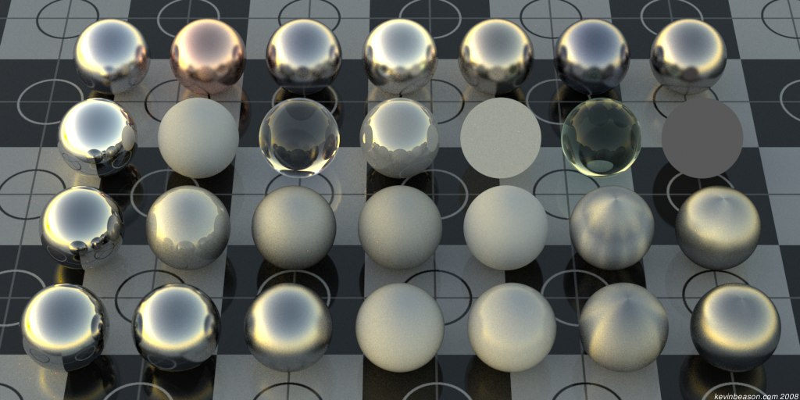
Materiales
BRDF:
[Bea08]
[Mee07]
Distintas BRDF describen distintos materiales

Slide 4



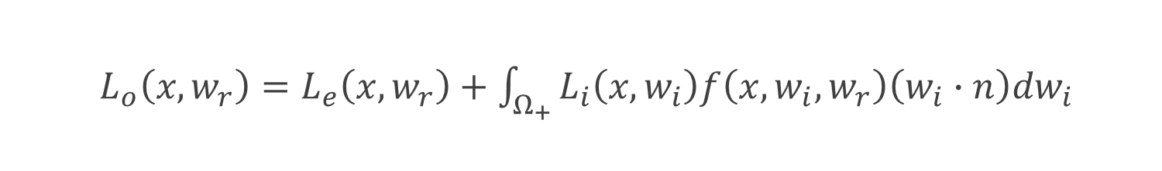



Ecuación de Renderizado
$${Ω }_{+}$$
$$w_{i}$$
$$n$$
$$w_{r}$$
$$x$$
$L_{o}\left(x, w_{r}\right)=L_{e}\left(x,w_{r}\right)+\int_{Ω_{+}}{L_{i}\left(x,w_{i}\right)f\left(x,w_{i},w_{r}\right)\left(w_{i}∙n\right)dw_{i}}$

Slide 5
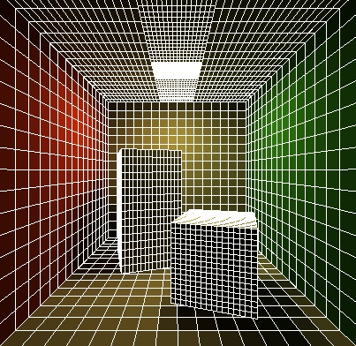
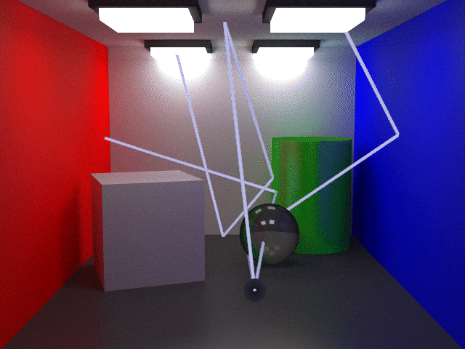
Procedimientos
Raytracing
radiosity
[Laf96]
[Sch16]

Slide 6
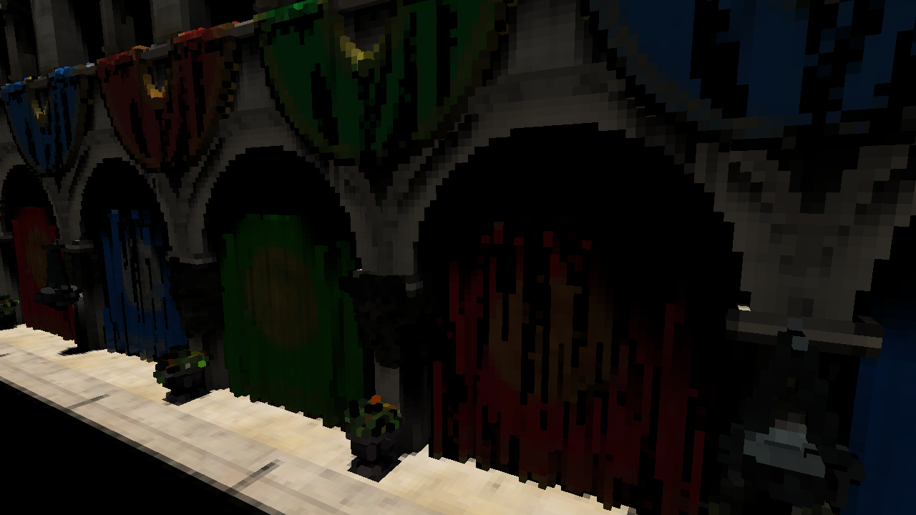
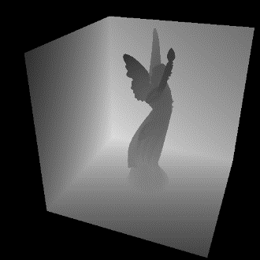
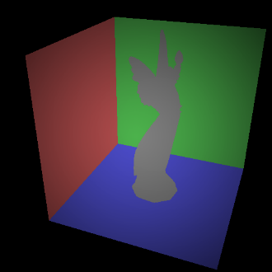
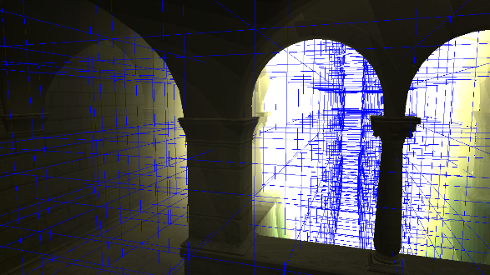
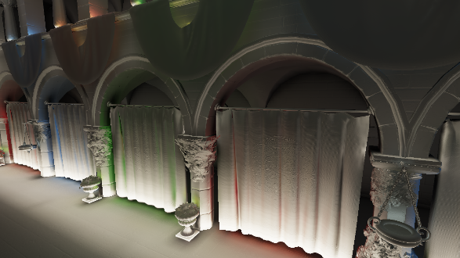
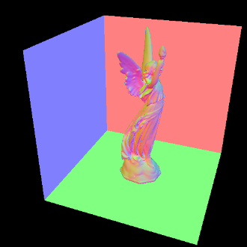
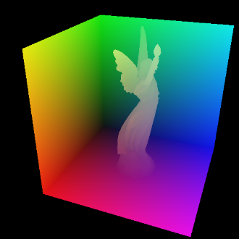
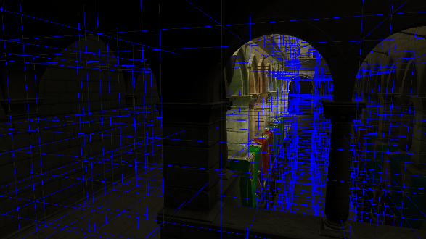
Iluminación Global en Tiempo Real
VCT
RSM
CLPV
[KD10]
[CNS+11]
[DS05]

Slide 8
Referencias
[RDG+12] Tobias Ritschel, Carsten Dachsbacher, Thorsten Grosch, and Jan Kautz. 2012. The State of the Art in Interactive Global Illumination. Comput. Graph. Forum 31, 1 (February 2012).
[Bea08] Kevin Beason. 2008. Glossy Reflections. http://www.kevinbeason.com/worklog/2009/03/20/glossy-reflections/
[Mee07] Meekohi. 2007. Diagram of incoming, outgoing, and normal vectors used in defining the Bidirection Reflectance Distribution Function
[Sch16] Mark Schmelzenbach. CS684 II: Radiosity. http://www.cs.utah.edu/~schmelze/radiosity/hw2/hw2.html
[Laf96] Eric Lafortune. 1996. Mathematical Models and Monte Carlo Algorithms for Physically Based Rendering

Slide 9
Referencias
[KD10] Anton Kaplanyan and Carsten Dachsbacher. 2010. Cascaded light propagation volumes for real-time indirect illumination. In Proceedings of the 2010 ACM SIGGRAPH symposium on Interactive 3D Graphics and Games (I3D '10). ACM, New York, NY, USA
[DS05] Carsten Dachsbacher and Marc Stamminger. 2005. Reflective shadow maps. In Proceedings of the 2005 symposium on Interactive 3D graphics and games (I3D '05). ACM, New York, NY, USA
[CNS+11] Cyril Crassin, Fabrice Neyret, Miguel Sainz, Simon Green, and Elmar Eisemann. 2011. Interactive indirect illumination using voxel cone tracing: a preview. In Symposium on Interactive 3D Graphics and Games (I3D '11). ACM, New York, NY, USA

